Slide 1
UMD DATA605 - Big Data Systems Storage Query Processing Transactions
GP Saggese
gsaggese@umd.edu
with thanks to Alan Sussman, Amol Deshpande

Slide 2
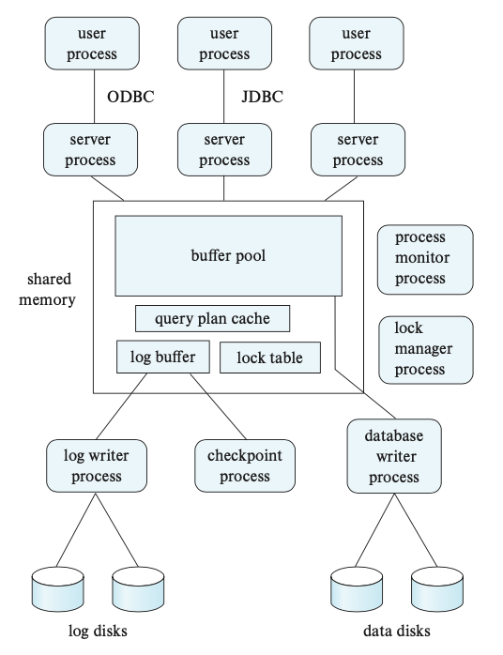
Centralized DB Internals
Lock manager process
Lock grant / release
Deadlock detection
DB writer process
Output modified buffer blocks back to disk on a continuous basis
Log writer process
Output log records to stable storage
Checkpoint process
Performs periodic checkpoints
Process monitor process
Monitor other processes
Recover processes from failures
Shared memory
Contain all shared data
Buffer pool
Lock table
Log buffer (log records waiting to be saved on stable storage)
Caches (e.g., query plans)
Data needs to be projected by mutual exclusion locks

Slide 3
Outline
Physical storage
Storage Hierarchy
Magnetic disks / SSD
RAID
Logical storage
File Organization
Buffer Manager
Indexes
Query Processing
Transactions
Sources:
Silberschatz et al. 2020, Chap 12, Physical Storage Systems

Slide 4
Storage Hierarchy
Storage media show a trade-off between:
speed of access
cost per unit of data
medium reliability
Volatile vs non-volatile
Volatile: loses contents when power switched off
Sequential vs random access
Sequential: read the data contiguously
SELECT * FROM employee
Random: read the data from anywhere at any time
SELECT * FROM employee WHERE name LIKE ‘__a__b’
Why care?
Need to know how data is stored in order to optimize access

Slide 5
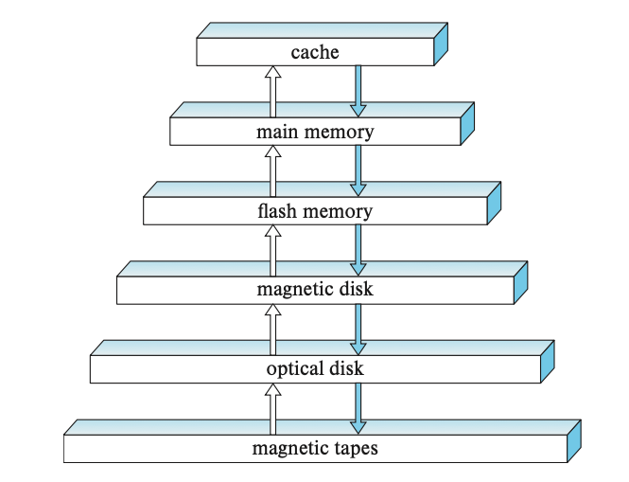
Storage Hierarchy
The various storage can be organized in a hierarchy according to speed and
cost
Cache
Fastest and most costly
DB developers do pay attention to cache effects
Main memory
Up to 100s of GBs
Typically can't store the entire DB
Volatile
Flash memory
Non-volatile
More expensive than RAM but less than magnetic disk
Magnetic-disk storage
Long-term on-line storage
Non-volatile (can survive failures and system crashes)
Optical storage
Mainly read-only
Tape storage
Backup and archival data (stored for long period of time, e.g., for legal reasons)
Sequential-access
Primary storage: cache and main memory
Secondary (or online): flash and magnetic disk
Offline: magnetic tape and optical

Slide 6
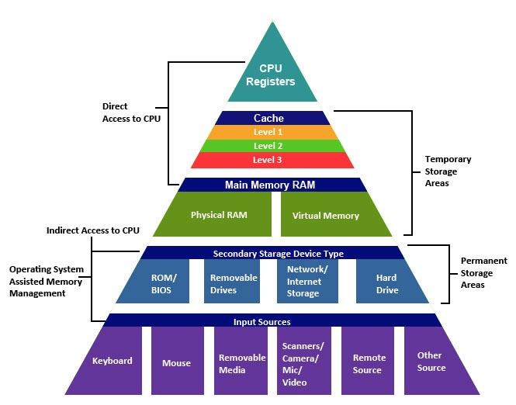
Storage Hierarchy
source: http://cse1.net/recaps/4-memory.html

Slide 7
How important is this today?
Trade-offs shifted drastically over last 10-15 years
Especially with fast network, SSDs, and large memories
However, the volume of data is also growing quite rapidly
Some observations:
Cheaper to access another computer’s memory than accessing your own disk
Cache is playing more and more important role
In-memory DBs: enough memory that data often fits in memory of a single machine, or a cluster of machines
“Disk” considerations less important
Still: disks are where most of the data lives today
Similar reasoning for algorithms required

Slide 8
Outline
Storage
Storage Hierarchy
Disks
RAID
Buffer Manager
File Organization
Indexes
Query Processing
Transactions

Slide 9
Connecting disks to a server
Magnetic disks and SSD can be connected directly to computer systems or connected to high-speed network
Connected to a computer through a high-speed interconnection
Serial ATA (SATA)
Serial Attached SCSI (SAS)
600MB / sec
NVMe (Non-volatile Memory Express)
High-speed networks with multiple storage and computers
Storage Area Network (SAN)
ISCSI
Fiber Channel
InfiniBand
Network Attached Storage (NAS)
Provides a file-system interface (e.g., NFS)
Cloud storage
Data is stored in the cloud and accessed via an API
Object store
High latency

Slide 10
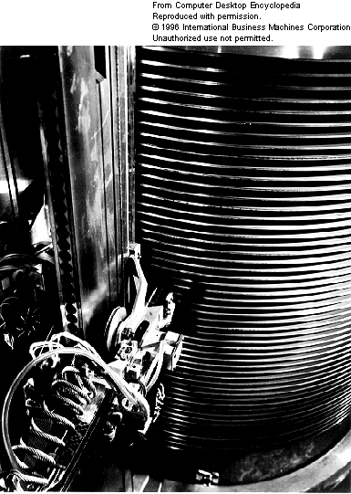
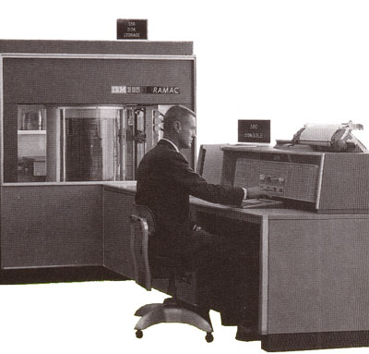
Magnetic disks
1956
IBM RAMAC
24” platters
100,000 characters each
5 million characters

Slide 11
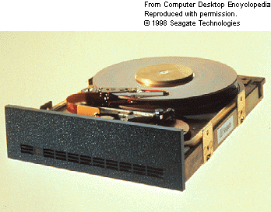
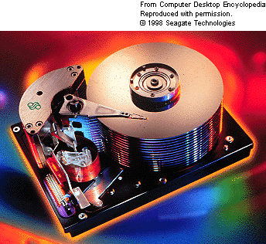

Magnetic disks
1979
SEAGATE
5MB
1998
SEAGATE
47GB
2006
Western Digital
500GB

Slide 12
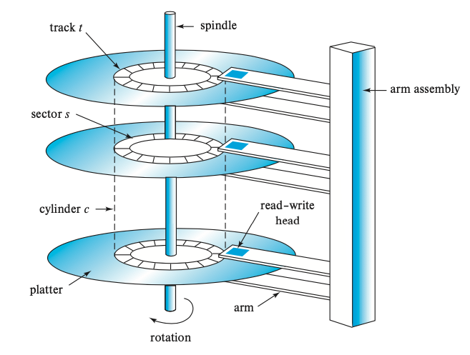
Magnetic disks
Platters
Made of rigid metal covered with magnetic material on both surfaces
It spins at 5400 or 9600 RPM
Tracks subdivided into sectors (smallest unit read or written)
Each sector has a checksum
Read-write head
Read-write head stores information magnetically on the disk
Spinning creates a cushion that maintain the heads a few microns from the disk surface
Cylinder is the i-th tracks of all the platters (since they can be read /
written together)
Arm
Move all the heads along the disks
Disk controller
Accepts high-level commands to read / write a sector
Operates heads, arms, platters
Bad sectors are remapped to a different physical location

Slide 13
Connecting disks to a server
Capacity
Terabyte and more
Access time
= time to start reading data
Seek time to move the arm across cylinders (2-20ms)
Rotational latency time = wait for sector to be accessed (4-12ms)
Data-transfer rate
Once the data is reached the transfer begins
Transfer rate = 50-200MB / secs
Disk block = logical unit of storage (4-16KB)
Sequential access = when the blocks are on the same or adjacent tracks
Random access = each request requires a seek
IOPS = number of random single block accesses in a second (50-200 IOPS)
Reliability
Mean time to failure (MTTF) is the amount of time that on average the system can run continuously without a failure
Life-span of an HDD is ~5 years

Slide 14
Accessing Data
Accessing a sector
Time to seek to the track (seek time)
average 4 to 10ms
+ Waiting for the sector to get under the head (rotational latency)
average 4 to 11ms
+ Time to transfer the data (transfer time)
very low
About 10ms per access
So if randomly accessed blocks, can only do 100 block transfers
100 x 512bytes = 50 KB/s
Data transfer rates
Rate at which data can be transferred (w/o any seeks)
30-50MB/s to up to 200MB/s (Compare to above)
Seeks are bad !

Slide 15
SSD
Like non-volatile RAM (NAND and NOR)
Require to read an entire "page" of data (typically 4KB)
Equivalent to a block in magnetic disks
Latency for random access is 1000x lower than HDD
e.g., 20-100us vs 10ms (HDD)
10,000 IOPS
Multiple random requests (e.g., 32) in parallel
Data transfer is higher than HDDs
GB/s vs 200MB/s (HDD)
Typically limited by the interface speed
Sequential reads and writes are ~500MB/s for SATA and 2-3 GB/s for NVMe
Lower power consumption than HDDs
Writing in SSD is slower than reading (e.g., 2-5 ms)
It requires erasing all pages in the block
There is a limit to how many times a flash page can be erased (~1m times)

Slide 16
Outline
Storage
Storage Hierarchy
Disks
RAID
Buffer Manager
File Organization
Indexes
Query Processing
Transactions

Slide 17
RAID
Redundant Array of Independent Disks
Problems
Data-storage requirements (e.g., web, DBs, multimedia applications) have been growing even faster than disk capacity
When you have a lot of disks (i.e., data), the MTTF between failure of any disk get smaller (e.g., days)
If we store a single copy of the data, the frequency of data loss is unacceptable
Observations:
Disks are very cheap
Failures are very costly
Use “extra” disks to ensure reliability
Store data redundantly
If one disk goes down, the data still survives
Bonus: Allow faster access to data
Goal: expose a logical view of large and reliable disks
Many RAID “levels”
Different reliability and performance properties

Slide 18
Improve reliability with RAID
Use redundancy
Store the same data multiple times
E.g., mirroring (aka shadowing)
If a disk fails, the data is not lost but it can be reconstructed
Mitigate the actual MTTF
Assumption is independence of disk failure
Power failures and natural disasters
As disks age, probability of failure increases together

Slide 19
Improve performance with RAID
Parallel access to multiple disks
E.g., with mirroring
Increase number of read requests
Same transfer rate
Striping data across multiple disks
Same number of accesses
Increase throughput since data is read / written in parallel

Slide 20
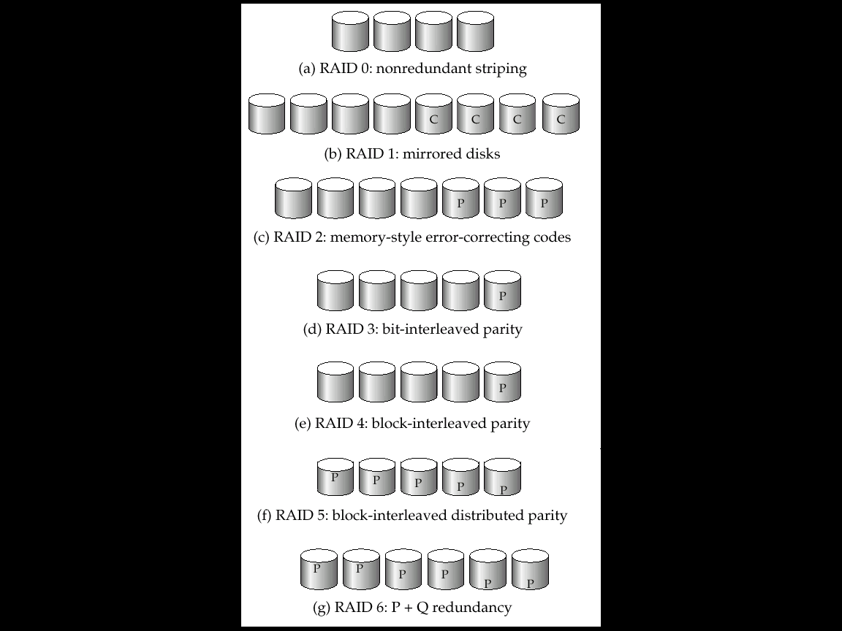
RAID Levels
(a) RAID 0: No redundancy
(b) RAID 1: Make a copy of the disks
If one disk goes down, we have a copy
Reads: Can go to either disk, so higher data rate possible
Writes: Need to write to both disks

Slide 21
RAID Levels
(c) RAID2: Memory-style Error Correcting
Keep extra bits around so we can reconstruct
Superseded by below
(d) RAID3: One disk contains “parity” for the main data disks
Can handle a single disk failure
Little overhead (only 25% in the above case)

Slide 22
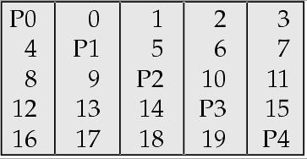
RAID Level 5
Distributed parity “blocks” instead of bits
Subsumes Level 4
Normal operation:
“Read” directly from the disk. Uses all 5 disks
“Write”: Need to read and update the parity block
To update 9 to 9’
read 9 and P2
compute P2’ = P2 xor 9 xor 9’
write 9’ and P2’

Slide 23
RAID Level 5
Failure operation (disk 3 has failed)
“Read block 0”: Read it directly from disk 2
“Read block 1” (which is on disk 3)
Read P0, 0, 2, 3 and compute 1 = P0 xor 0 xor 2 xor 3
“Write”:
To update 9 to 9’
read 9 and P2
Oh… P2 is on disk 3
So no need to update it
Write 9’

Slide 24
Choosing a RAID level
Main choice between RAID 1 and RAID 5
RAID 1 better write performance than level 5
RAID 5: 2 block reads and 2 block writes to write a single block
RAID 1: only requires 2 block writes
RAID 1 preferred for high update environments such as log disks
RAID 5 lower storage cost
RAID 1 60% more disks
RAID 5 is preferred for applications with low update rate, and large amounts of data

Slide 25
Disk-block access
DB systems (i.e., the query processing sub-system) generate requests for disk I/O
Data can be stored on OS files
Can specify directly logical block
In case of direct block access techniques to reduce number of random accesses (especially for magnetic disks, less for SSD)
Buffering
Data is read in memory waiting for future requests
Read-ahead
Consecutive blocks are read from the same track to minimize seek time
Scheduling
Read blocks as they pass under the head to minimize disk-arm movement
E.g., elevator algorithm
File organization
If data is accessed sequentially keep all data in blocks on adjacent cylinders
Defragmentation
Due to appends to sequential files, the data becomes scattered over the disk
Make a copy of the sequential data and delete the old one
Non-volatile write buffers
Save data in non-volatile RAM to speed-up writes and survive system crashes

Slide 26
Outline
Storage
Storage Hierarchy
Disks
RAID
Buffer Manager
File Organization
Indexes
Query Processing
Transactions
Sources:
Silberschatz et al. 2020, Chap 13: Data Storage Structures

Slide 27
Outline
Storage
Storage Hierarchy
Disks
RAID
Buffer Manager
File Organization
Indexes
Query Processing
Transactions

Slide 28
File Organization
We need to map:
Table (aka relations)
Records (aka tuples, rows)
Attributes (aka fields)
to blocks (aka pages) and files
How are the tables mapped to disk blocks (e.g., 4-8 KBs)?
Use a standard OS file system
DB needs to be aware of underlying blocks
High-end DB systems have their own OS
OS interferes more than helps in many cases
Read / write directly disk blocks
Mapping of tables to file
One-to-one?
Advantages in storing multiple tables clustered together (e.g., joins)
A file is essentially a collection of disk blocks
How are the tuples mapped to the disk blocks?
How are they stored within each block?

Slide 29
File Organization
Goals:
Fetch a particular record (specified by record id)
Allow insertion / deletions of records in the table
Find all records that match a condition (say SSN = 123)
Simplest case
Each table is mapped to a file
No record is larger than a block
Each record is contained in a single block (records are not split between blocks)
A file contains a sequence of records
Problem
Attributes are of different sizes
How are records stored within a block?
Fixed-length records
Variable-length records

Slide 30
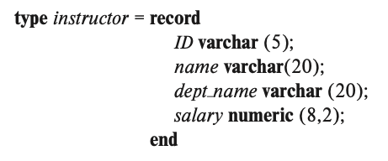
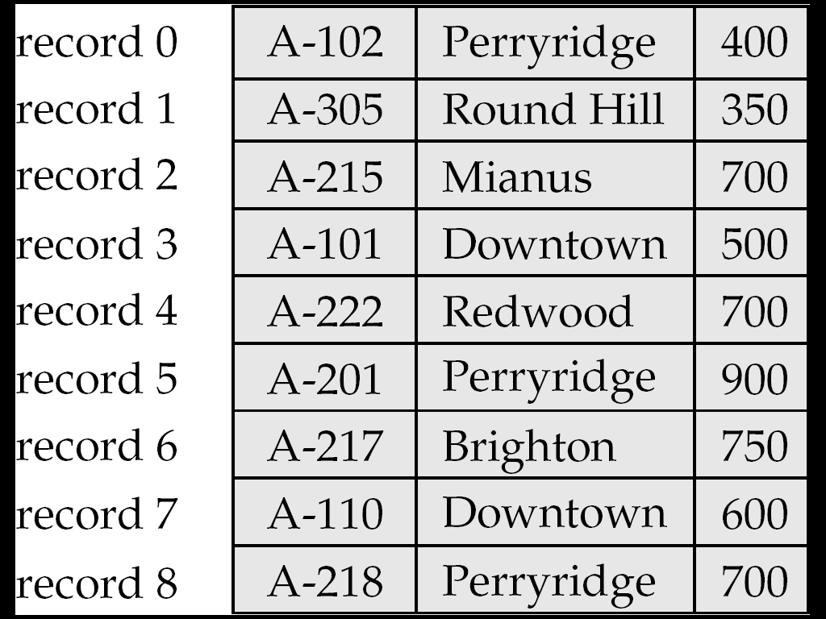
Fixed-length Records
n = number of bytes per record
E.g., a record in instructor requires 53 bytes
char -> 1 byte
numeric(8, 2) -> 8 bytes
...
Store record i at position
offset = (i – 1) * n
The block can contain not an integer number of records
Leave bytes unused
Inserting a tuple
Depends on the policy used
Simply append at the end of the record
Deleting a tuple
Rearrange (move all the records to reclaim space)
Leave space unused
Keep a free list and use for next insert
Deletes are much less frequent than insertions

Slide 31
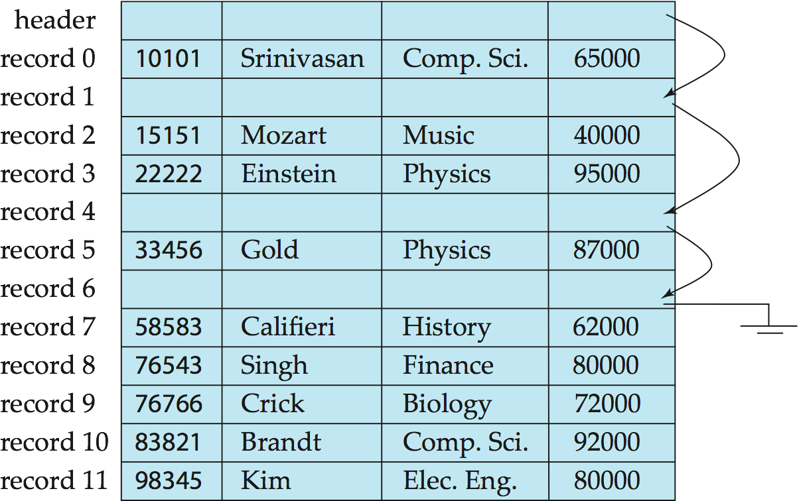
Fixed-length Records
Deleting using “free lists”
Like a linked list of free blocks
E.g., after deleting record 1, 4, 6
Conceptually store pointers
In practice file header

Slide 32
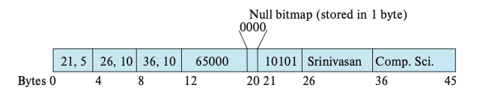
Variable-length Records
Variable-length records occur due to:
The presence of variable length fields (e.g., strings, arrays, sets)
Multiple record types in the same file
How to extract an attribute of variable length of a record?
The fixed length attributes are allocated statically
For variable-length attributes (e.g., `VARCHAR` type) are represented by an offset and length
Null bitmap stores which attributes of the record have a null value

Slide 33
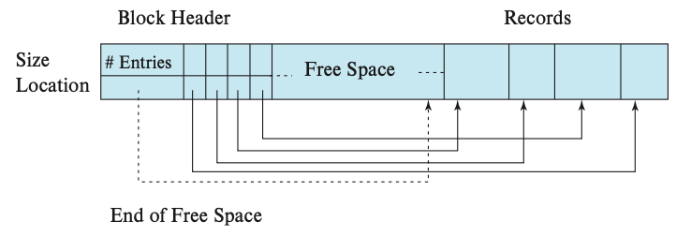
Variable-length Records
How to extract a record (of variable length) from a block
Slotted-page structure
Number of record entries
Array with location and size of each record (indirection)
No pointers directly to records
Pointers to the entry in the header that contains the location of the record
The records may move inside the block, but the outside world is oblivious to it
End of free space in the block

Slide 34
Organization of Records in Files
Which block of a file should a record go to?
Anywhere?
Called “heap” organization
How to search for “SSN = 123”?
Sorted by key?
Called “sequential” organization
Keeping it sorted would be painful
How would you search?
Based on a “hash” key
Called “hashing” organization
Store the record with SSN = x in the block number x%1000
Why?

Slide 35
Heap Record organization
Records are allocated contiguously
A new record is appended at the end of free space and the header is updated
A new record is deleted, the space is freed, the entry is deleted

Slide 36
Sequential Record Organization
Keep sorted by some search key
Insertion
Find the block in which the tuple should be
If there is free space, insert it
Otherwise, must create overflow pages
Deletions
Delete and keep the free space
Databases tend to be insert heavy, so free space gets used fast
Can become fragmented
Must reorganize once in a while

Slide 37
Sequential File Organization
What if I want to find a particular record by value ?
Account info for SSN = 123
Binary search
Takes log(n) number of disk accesses
Random accesses
Too much
n = 1,000,000,000 -- log(n) = 30
Recall each random access approximately 10 ms
300 ms to find just one account information
< 4 requests satisfied per second

Slide 38
DB internals
user
query
results
Query Processing Engine
Given a input user query, decide how to “execute” it
Specify sequence of pages to be brought in memory
Operate upon the tuples to produce results
Query Processing Engine
page requests
pointers
to pages
Buffer Manager
Bringing pages from disk to memory
Managing the limited memory
Buffer Management
block requests
data
Space Management on Persistent Storage (e.g., Disks)
Storage hierarchy
How are relations mapped to files?
How are tuples mapped to disk blocks?

Slide 39
Buffer Manager
Many DBs are much larger than available memory on servers
DB data resides on disk
When the Query Processor Engine wants a block, it asks the Buffer manager
The block must be in memory to operate upon
Buffer pool
Copy of disk blocks in memory
Like OS virtual memory
Buffer manager
If block already in memory, return a pointer to it
If not:
Allocate space, evicting a current page
Either write it back to its original location,
or just throw it away (if it was read from disk, and not modified)
Read data
Make a request to the storage subsystem to fetch it
Pass the address back
Lke a OS virtual memory manager

Slide 40
Buffer Manager
Page Requests from Higher Levels
BUFFER POOL
disk page
free frame
MAIN MEMORY
DISK
choice of frame dictated
by replacement policy
DB

Slide 41
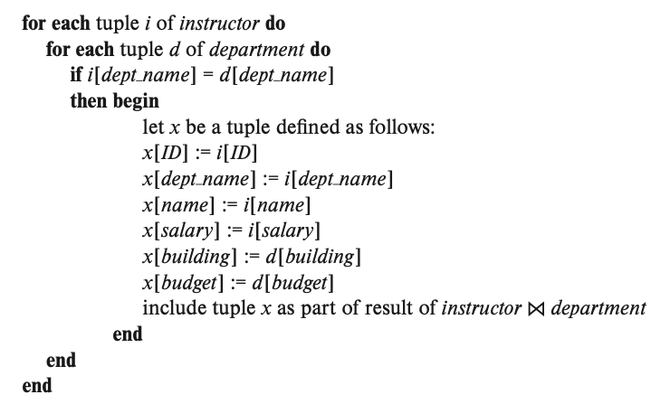
Buffer Manager
Similar to virtual memory manager
Buffer replacement policies
What page to evict?
LRU: Least Recently Used
Throw out the page that was not used in a long time
MRU: Most Recently Used
The opposite
E.g., during a join there is a nested loop, the block just used won’t be used until the next iteration

Slide 42
Buffer Manager
Pinning a block
There can be multiple concurrent processes
One block was just read and another query tries to evict it
One query pins / unpins the block to lock it while it's being used
Writing-ahead a block
The DB can write the update block to disk before it's evicted
When the space of that block is needed (eviction), no need to wait the write to go through
Forced output of blocks
If there is a crash, the buffer pool and the memory content are lost, while data survives a crash
It is necessary to write a block to disk to make sure the transaction was "committed"

Slide 43
Outline
Storage
Storage Hierarchy
Disks
RAID
Buffer Manager
File Organization
Indexes
Query Processing
Transactions

Slide 44
Index
A data structure for efficient search through large databases
Two key ideas:
The records are mapped to the disk blocks in specific ways
Sorted, or hash-based
Auxiliary data structures are maintained that allow quick search
Think library index/catalogue
Search key:
Attribute or set of attributes used to look up records
E.g. SSN for a persons table
Two types of indexes
Ordered indexes
Hash-based indexes

Slide 45
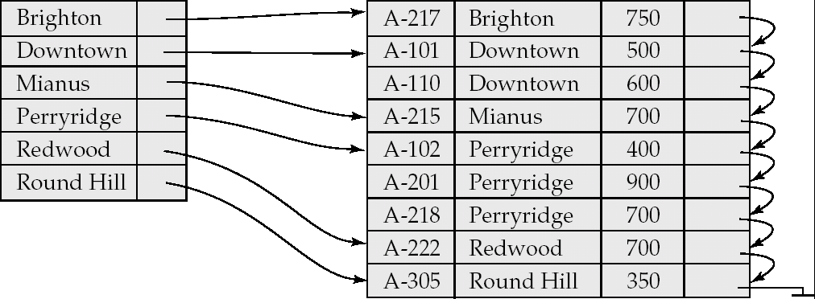
Ordered Indexes
Primary index
The relation is sorted on the search key of the index
Secondary index
It is not
Can have only one primary index on a relation
^{Index}
^{Relation}

Slide 46
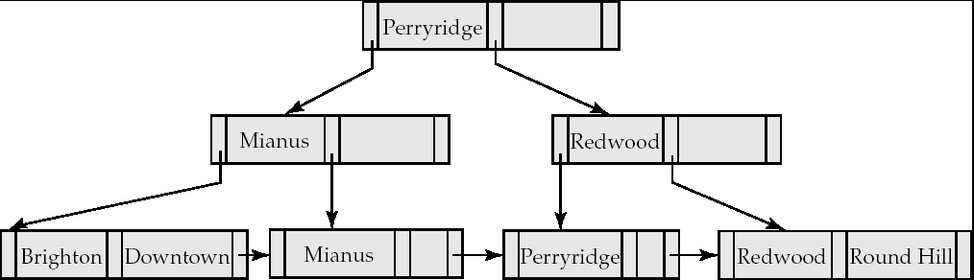
Example B+-Tree Index
^{Index}

Slide 47
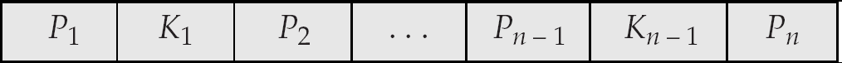
B⁺-Tree Node Structure
Typical node
K_{i} are the search-key values
P_{i} are pointers to children (for non-leaf nodes) or pointers to records or buckets of records (for leaf nodes).
The search-keys in a node are ordered
K₁ < K₂ < K₃ < . . . < K_{n–1}

Slide 48

Properties of B+-Trees
It is balanced
Every path from the root to a leaf is same length
Leaf nodes (at the bottom)
P₁ contains the pointers to tuple(s) with key K₁
…
P_{n} is a pointer to the next leaf node
Must contain at least n/2 entries

Slide 49
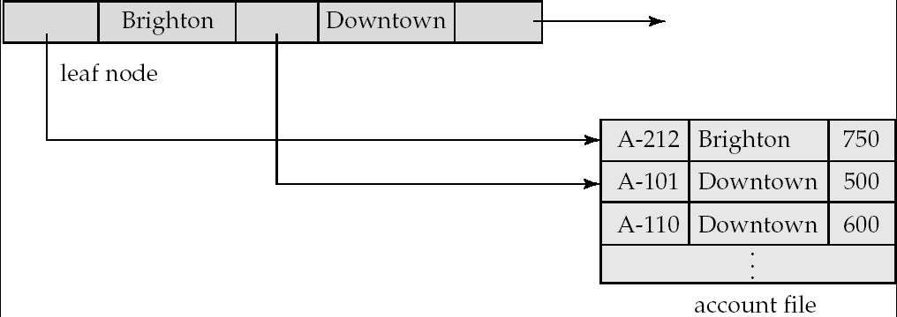
Example B+-Tree Index
^{Index}

Slide 50
Properties
Interior nodes
All tuples in the subtree pointed to by P₁, have search key < K₁
To find a tuple with key K₁’ < K₁ , follow P₁
…
Finally, search keys in the tuples contained in the subtree pointed to by P_{n}, are all larger than K_{n-1}
Must contain at least n/2 entries (unless root)

Slide 51
Example B+-Tree Index
^{Index}

Slide 52
Outline
Storage
Query Processing
Selection operation
Join operators
Sorting
Other operators
Putting it all together…
Transactions

Slide 53
Overview
User
SELECT *
FROM R, S
where …
Resolve the references,
Syntax errors etc.
Converts the query to an
internal format
relational algebra like
Query Parser
Query Optimizer
Results
Find the best way to evaluate
the query
Which index to use?
What join method to use?
…
Query Processor
Read the data from the files
Do the query processing
joins, selections, aggregates
…
R, B+Tree on R.a
S, Hash Index on S.a
…

Slide 54
“Cost”
Complicated to compute
We will focus on disk:
Number of I/Os?
Not sufficient
Number of seeks matters a lot… why ?
t_{T} – time to transfer one block
t_{S} – time for one seek
Cost for b block transfers plus S seeks b * t_{T} + S * t_{S}
Measured in seconds

Slide 55
Outline
Storage
Query Processing
Selection operation
Join operators
Sorting
Other operators
Putting it all together…
Transactions

Slide 56
Selection Operation
SELECT * FROM person WHERE SSN = “123”
Option 1: Sequential Scan
Read the relation start to end and look for “123”
Can always be used (not true for the other options)
Cost
Let b_{r} = Number of relation blocks
Then:
1 seek and b_{r} block transfers
So:
t_{S} + b_{r} * t_{T} sec
Improvements:
If SSN is a key, then can stop when found
So on average, b_{r}/2 blocks accessed

Slide 57
Selection Operation
SELECT * FROM person WHERE SSN = “123”
Option 2 : Binary Search
Pre-condition:
The relation is sorted on SSN
Selection condition is an equality
E.g. can’t apply to “Name like ‘%424%’”
Do binary search
Cost of finding the first tuple that matches
⎡log₂(b_{r})⎤ * (t_{T} + t_{S})
All I/Os are random, so need a seek for all
The last few are closeby, but we ignore such small effects
Not quite: what if 10,000 tuples match the condition?
Incurs additional cost

Slide 58
Selection Operation
SELECT * FROM person WHERE SSN = “123”
Option 3 : Use Index
Pre-condition:
An appropriate index must exist
Use the index
Find the first leaf page that contains the search key
Retrieve all the tuples that match by following the pointers
If primary index, the relation is sorted by the search key
Go to the relation and read blocks sequentially
If secondary index, must follow all pointers using the index

Slide 59
Query Processing
Overview
Selection operation
Join operators
Sorting
Other operators
Putting it all together…

Slide 60
Join
SELECT * FROM R, S WHERE R.a = S.a
Called an “equi-join”
SELECT * FROM R, S WHERE |R.a – S.a | < 0.5
Not an “equi-join”
Option 1: Nested-loops
for each tuple r in R
for each tuple s in S
check if r.a = s.a (or whether |r.a – s.a| < 0.5)
Can be used for any join condition
As opposed to some algorithms we will see later
R called outer relation
S called inner relation

Slide 61
Nested-loops Join
Cost? Depends on the actual values of parameters, especially memory
b_{r}, b_{s} 🡪 Number of blocks of R and S
n_{r}, n_{s} 🡪 Number of tuples of R and S
Case 1: Minimum memory required = 3 blocks
One to hold the current R block, one for current S block, one for the result being produced
Blocks transferred:
Must scan R tuples once: b_{r}
For each R tuple, must scan S: n_{r} * b_{s}
Seeks?
n_{r} + b_{r}

Slide 62
Nested-loops Join
Case 1: Minimum memory required = 3 blocks
Blocks transferred: n_{r} * b_{s} + b_{r}
Seeks: n_{r} + b_{r}
Example:
Number of records -- R: n_{r} = 10,000, S: n_{s} = 5000
Number of blocks -- R: b_{r} = 400 , S: b_{s} = 100
Then:
blocks transferred: 10000 * 100 + 400 = 1,000,400
seeks: 10400
What if we were to switch R and S ?
2,000,100 block transfers, 5100 seeks
Matters

Slide 63
Nested-loops Join
Case 2: S fits in memory
Blocks transferred: b_{s} + b_{r}
Seeks: 2
Example:
Number of records -- R: n_{r} = 10,000, S: n_{s} = 5000
Number of blocks -- R: b_{r} = 400 , S: b_{s} = 100
Then:
blocks transferred: 400 + 100 = 500
seeks: 2
This is orders of magnitude difference

Slide 64
Hash Join
Case 1: Smaller relation (S) fits in memory
Nested-loops join:
for each tuple r in R
for each tuple s in S
check if r.a = s.a
Cost: b_{r} + b_{s} transfers, 2 seeks
The inner loop is not exactly cheap (high CPU cost)
Hash join:
read S in memory and build a hash index on it
for each tuple r in R
use the hash index on S to find tuples such that S.a = r.a

Slide 65
Hash Join
Case 1: Smaller relation (S) fits in memory
Hash join:
read S in memory and build a hash index on it
for each tuple r in R
use the hash index on S to find tuples such that S.a = r.a
Cost: b_{r} + b_{s} transfers, 2 seeks (unchanged)
Why good ?
CPU cost is much better (even though we don’t care about it too much)
Performs much better than nested-loops join when S doesn’t fit in memory (next)

Slide 66
Hash Join
Case 2: Smaller relation (S) doesn’t fit in memory
Two “phases”
Phase 1:
Read the relation R block by block and partition it using a hash function, h1(a)
Create one partition for each possible value of h1(a)
Write the partitions to disk
R gets partitioned into R1, R2, …, Rk
Similarly, read and partition S, and write partitions S1, S2, …, Sk to disk
Only requirement:
Each S partition fits in memory

Slide 67
Hash Join
Case 2: Smaller relation (S) doesn’t fit in memory
Two “phases”
Phase 2:
Read S1 into memory, and build a hash index on it (S1 fits in memory)
Using a different hash function, h₂(a)
Read R1 block by block, and use the hash index to find matches.
Repeat for S2, R2, and so on.

Slide 68
Hash Join
Case 2: Smaller relation (S) doesn’t fit in memory
Two “phases”:
Phase 1:
Partition the relations using one hash function, h₁(a)
Phase 2:
Read S_{i} into memory, and build a hash index on it (S_{i} fits in memory)
Read R_{i} block by block, and use the hash index to find matches.
Cost?
3(b_{r} + b_{s}) +4 * n_{h} block transfers + 2( ⎡b_{r} / b_{b}⎤ + ⎡b_{s} / b_{b}⎤) seeks
Where b_{b} is the size of each output buffer
Much better than Nested-loops join under the same conditions

Slide 69
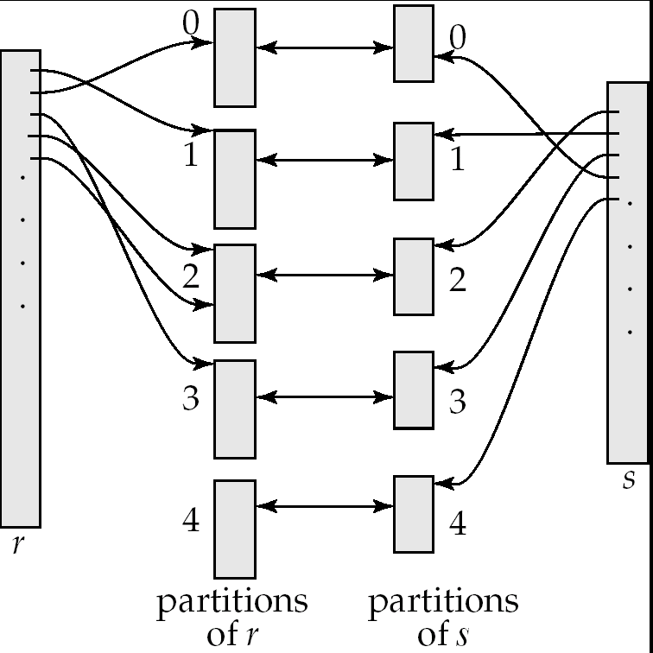
Hash Join

Slide 70
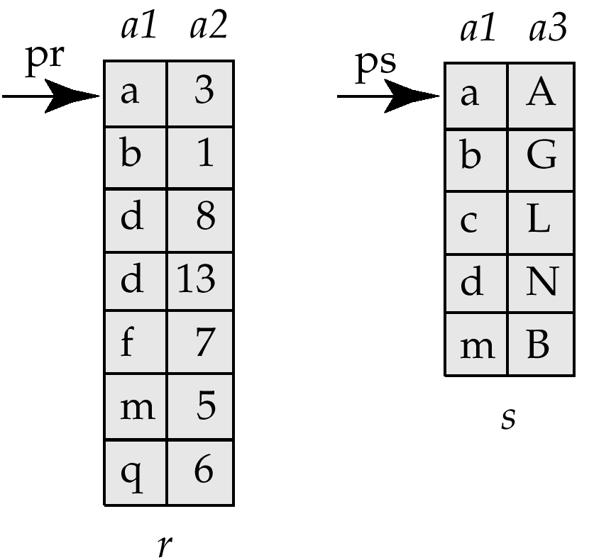
Merge-Join (Sort-merge join)
Pre-condition:
The relations must be sorted by the join attribute
If not sorted, can sort first, and then use this algorithms
Called “sort-merge join” sometimes
select *
from r, s
where r.a1 = s.a1
Step:
1. Compare the tuples at pr and ps
2. Move pointers down the list
- Depending on the join condition
3. Repeat

Slide 71
Merge-Join (Sort-merge join)
Cost:
If the relations sorted, then just
b_{r} + b_{s} block transfers, some seeks depending on memory size
What if not sorted?
Then sort the relations first
In many cases, still very good performance
Typically comparable to hash join
Observation:
The final join result will also be sorted on a1
This might make further operations easier to do
E.g., duplicate elimination

Slide 72
Joins: Summary
Block Nested-loops join
Can always be applied irrespective of the join condition
Index Nested-loops join
Only applies if an appropriate index exists
Hash joins – only for equi-joins
Join algorithm of choice when the relations are large
Hybrid hash join
An optimization on hash join that is always implemented
Sort-merge join
Very commonly used – especially since relations are typically sorted
Sorted results commonly desired at the output
To answer group by queries, for duplicate elimination, because of ASC/DSC

Slide 73
Query Processing
Overview
Selection operation
Join operators
Sorting
Other operators
Putting it all together…

Slide 74
Sorting
Commonly required for many operations
Duplicate elimination, group by’s, sort-merge join
Queries may have ASC or DSC in the query
One option:
Read the lowest level of the index
May be enough in many cases
But if relation not sorted, this leads to too many random accesses
If relation small enough…
Read in memory, use quick sort (qsort() in C)
What if relation too large to fit in memory ?
External sort-merge

Slide 75
External sort-merge
Divide and Conquer !!
Let M denote the memory size (in blocks)
Phase 1:
Read first M blocks of relation, sort, and write it to disk
Read the next M blocks, sort, and write to disk …
Say we have to do this “N” times
Result: N sorted runs of size M blocks each
Phase 2:
Merge the N runs (N-way merge)
Can do it in one shot if N < M

Slide 76
External sort-merge
Phase 1:
Create sorted runs of size M each
Result: N sorted runs of size M blocks each
Phase 2:
Merge the N runs (N-way merge)
Can do it in one shot if N < M
What if N > M ?
Do it recursively
Not expected to happen
If M = 1000 blocks = 4MB (assuming blocks of 4KB each)
Can sort: 4000MB = 4GB of data

Slide 77
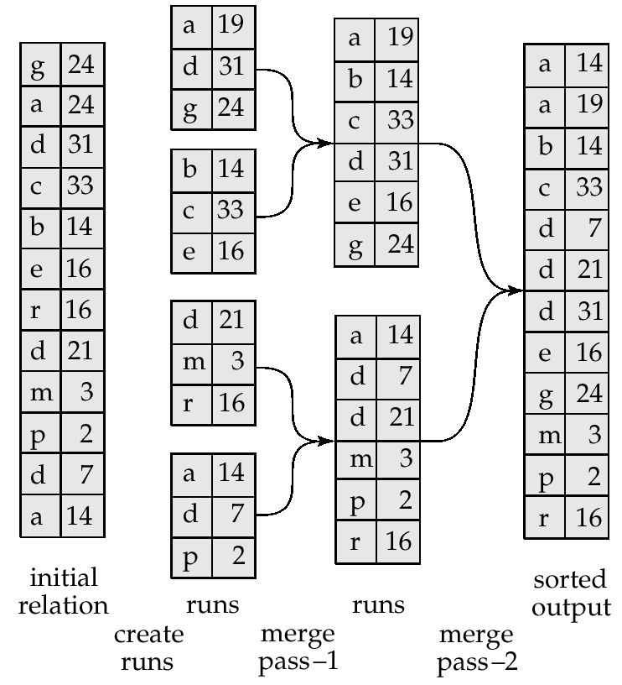
Example: External Sorting Using Sort-Merge

Slide 78
External Merge Sort (Cont.)
Cost analysis:
Total number of merge passes required: ⎡log_{M–1}(b_{r}/M)⎤.
Disk accesses for initial run creation as well as in each pass is 2b_{r}
for final pass, we don’t count write cost
we ignore final write cost for all operations since the output of an operation may be sent to the parent operation without being written to disk
Thus total number of disk accesses for external sorting:
b_{r} ( 2 ⎡log_{M–1}(b_{r} / M)⎤ + 1)

Slide 79
Query Processing
Overview
Selection operation
Join operators
Sorting
Other operators
Putting it all together…

Slide 80
Group By and Aggregation
select a, count(b)
from R
group by a;
Hash-based algorithm
Steps:
Create a hash table on a, and keep the count(b) so far
Read R tuples one by one
For a new R tuple, “r”
Check if r.a exists in the hash table
If yes, increment the count
If not, insert a new value

Slide 81
Group By and Aggregation
select a, count(b)
from R
group by a;
Sort-based algorithm
Steps:
Sort R on a
Now all tuples in a single group are contigous
Read tuples of R (sorted) one by one and compute the aggregates

Slide 82
Group By and Aggregation
select a, AGGR(b) from R group by a;
sum(), count(), min(), max(): only need to maintain one value per group
Called “distributive”
average() : need to maintain the “sum” and “count” per group
Called “algebraic”
stddev(): algebraic, but need to maintain some more state
median(): can do efficiently with sort, but need two passes (called “holistic”)
First to find the number of tuples in each group, and then to find the median tuple in each group
count(distinct b): must do duplicate elimination before the count

Slide 83
Duplicate Elimination
select distinct a
from R ;
Best done using sorting – Can also be done using hashing
Steps:
Sort the relation R
Read tuples of R in sorted order
prev = null;
for each tuple r in R (sorted)
if r != prev then
Output r
prev = r
else
Skip r

Slide 84
Set operations
(select * from R) union (select * from S) ;
(select * from R) intersect (select * from S) ;
(select * from R) union all (select * from S) ;
(select * from R) intersect all (select * from S) ;
Remember the rules about duplicates
“union all”: just append the tuples of R and S
“union”: append the tuples of R and S, and do duplicate elimination
“intersection”: similar to joins
Find tuples of R and S that are identical on all attributes
Can use hash-based or sort-based algorithm

Slide 85
Query Processing
Overview
Selection operation
Join operators
Sorting
Other operators
Putting it all together…

Slide 86
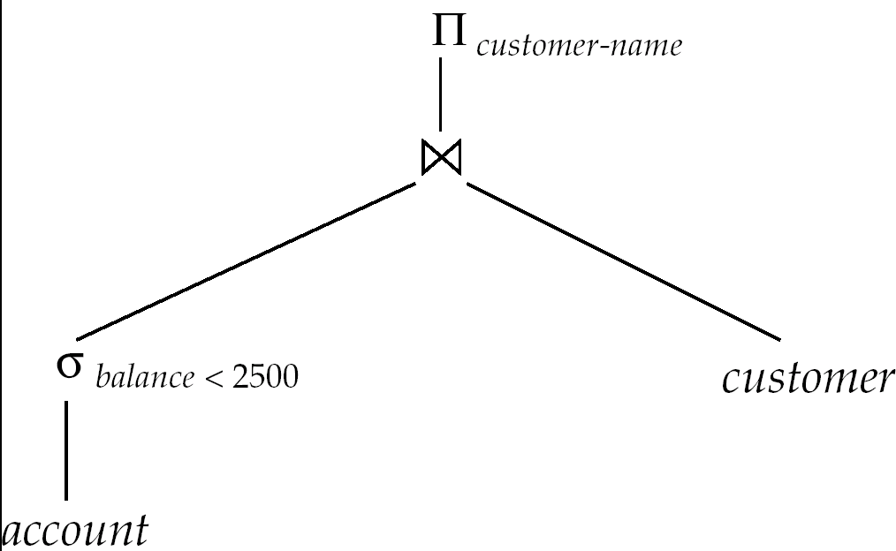
Evaluation of Expressions
select customer-name
from account a, customer c
where a.SSN = c.SSN and
a.balance < 2500
Two options:
Materialization
Pipelining

Slide 87
Evaluation of Expressions
Materialization
Evaluate each expression separately
Store its result on disk in temporary relations
Read it for next operation
Pipelining
Evaluate multiple operators simultaneously
Skip the step of going to disk
Usually faster, but requires more memory
Also not always possible..
E.g., Sort-Merge Join
Harder to reason about

Slide 88
Materialization
Materialized evaluation is always applicable
Cost of writing results to disk and reading them back can be quite high
Our cost formulas for operations ignore cost of writing results to disk, so
Overall cost = Sum of costs of individual operations + cost of writing intermediate results to disk
Double buffering: use two output buffers for each operation, when one is full write it to disk, while the other is getting filled
Allows overlap of disk writes with computation and reduces execution time

Slide 89
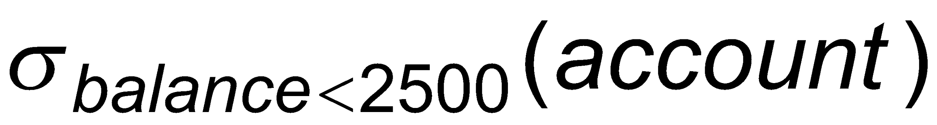
Pipelining
Evaluate several operations simultaneously, passing the results of one operation on to the next.
E.g., in previous expression tree, don’t store result of
instead, pass tuples directly to the join.. Similarly, don’t store result of join, pass tuples directly to projection.
Much cheaper: no need to store a temporary relation to disk.
Requires higher amount of memory
All operations are executing at the same time (say as processes)
Somewhat limited applicability
A “blocking” operation: An operation that has to consume entire input before it starts producing output tuples

Slide 90
Pipelining
Need operators that generate output tuples while receiving tuples from their inputs
Selection: Usually yes.
Sort: NO. The sort operation is blocking
Sort-merge join: The final (merge) phase can be pipelined
Hash join: The partitioning phase is blocking; the second phase can be pipelined
Aggregates: Typically no. Need to wait for the entire input before producing output
However, there are tricks you can play here
Duplicate elimination: Since it requires sort, the final merge phase could be pipelined
Set operations: see duplicate elimination

Slide 91
Transactions
Overview
Concurrency Control
Recovery

Slide 92
Overview
Transaction: A sequence of database actions enclosed within special tags
Properties:
Atomicity: Entire transaction or nothing
Consistency: Transaction, executed completely, takes database from one consistent state to another
Isolation: Concurrent transactions appear to run in isolation
Durability: Effects of committed transactions are not lost
Consistency: transaction programmer needs to guarantee that
DBMS can do a few things, e.g., enforce constraints on the data
Rest: DBMS guarantees

Slide 93
Bank application example
TODO

Slide 94
How does..
.. this relate to queries that we discussed ?
Actual queries don’t update data, so durability and consistency not relevant
Would want concurrency
Consider a query computing total balance at the end of the day
Would want isolation
What if somebody makes a transfer while we are computing the balance
Typically not guaranteed for such long-running queries

Slide 95
Performance benchmark
Transaction per minute
TPC-C:
OLTP application
a wholesale distributor with a small number of warehouses full of inventory servicing a larger number of retail locations
Heady on disk I/O
TPC-E:
modern OLTP application
a stock brokerage, simulated world driven by fluctuating stock prices and outside world of customers placing market orders, limit orders and stop-limit orders
Heavy on RAM
TPC-H
OLAP application
Query analytics in a 'data warehouse' context

Slide 96
Assumptions and Goals
Assumptions:
The system can crash at any time
Similarly, the power can go out at any point
Contents of the main memory won’t survive a crash, or power outage
BUT… disks are durable. They might stop, but data is not lost.
Disks only guarantee atomic sector writes, nothing more
Transactions are by themselves consistent
Goals:
Guaranteed durability, atomicity
As much concurrency as possible, while not compromising isolation and/or consistency
Two transactions updating the same account balance… NO
Two transactions updating different account balances… YES

Slide 97
Transactions
Overview
Concurrency Control
Recovery

Slide 98
Lock-based Protocols
A transaction must get a lock before operating on the data
Two types of locks:
Shared (S) locks (also called read locks)
Obtained if we want to only read an item
Exclusive (X) locks (also called write locks)
Obtained for updating a data item

Slide 99
Lock instructions
New instructions
- lock-S: shared lock request
- lock-X: exclusive lock request
- unlock: release previously held lock
Example schedule:
T1
T2
read(B)
B 🡨B-50
write(B)
read(A)
A 🡨A + 50
write(A)
read(A)
read(B)
display(A+B)

Slide 100
Lock instructions
New instructions
- lock-S: shared lock request
- lock-X: exclusive lock request
- unlock: release previously held lock
Example schedule:
T1
T2
lock-X(B)
read(B)
B 🡨B-50
write(B)
unlock(B)
lock-X(A)
read(A)
A 🡨A + 50
write(A)
unlock(A)
lock-S(A)
read(A)
unlock(A)
lock-S(B)
read(B)
unlock(B)
display(A+B)

Slide 101
Lock-based Protocols
Lock requests are made to the concurrency control manager
It decides whether to grant a lock request
T1 asks for a lock on data item A, and T2 currently has a lock on it?
Depends
If compatible, grant the lock, otherwise T1 waits in a queue.
T2 lock type | T1 lock type | Should allow ?
Shared | Shared | YES
Shared | Exclusive | NO
Exclusive | - | NO

Slide 102
Snapshot Isolation
Very popular scheme, used as the primary scheme by many systems including Oracle, PostgreSQL etc…
Several others support this in addition to locking-based protocol
A type of “optimistic concurrency control”
Key idea:
For each object, maintain past “versions” of the data along with timestamps
Every update to an object causes a new version to be generated

Slide 103
Snapshot Isolation
Read queries:
Let “t” be the “time-stamp” of the query, i.e., the time at which it entered the system
When the query asks for a data item, provide a version of the data item that was latest as of “t”
Even if the data changed in between, provide an old version
No locks needed, no waiting for any other transactions or queries
The query executes on a consistent snapshot of the database
Update queries (transactions):
Reads processed as above on a snapshot
Writes are done in private storage
At commit time, for each object that was written, check if some other transaction updated the data item since this transaction started
If yes, then abort and restart
If no, make all the writes public simultaneously (by making new versions)

Slide 104
Snapshot Isolation
Advantages:
Read query don’t block at all, and run very fast
As long as conflicts are rare, update transactions don’t abort either
Overall better performance than locking-based protocols
Major disadvantage:
Not serializable
Inconsistencies may be introduced
See the wikipedia article for more details and an example
http://en.wikipedia.org/wiki/Snapshot_isolation

Slide 105
Transactions
Overview
Concurrency Control
Recovery

Slide 106
Context
ACID properties:
We have talked about Isolation and Consistency
How do we guarantee Atomicity and Durability?
Atomicity: Two problems
Part of the transaction is done, but we want to cancel it
ABORT/ROLLBACK
System crashes during the transaction. Some changes made it to the disk, some didn’t.
Durability:
Transaction finished. User notified. But changes not sent to disk yet (for performance reasons). System crashed.
Essentially similar solutions

Slide 107
Reasons for crashes
Transaction failures
Logical errors: transaction cannot complete due to some internal error condition
System errors: the database system must terminate an active transaction due to an error condition (e.g., deadlock)
System crash
Power failures, operating system bugs, etc.
Fail-stop assumption: non-volatile storage contents are assumed to not be corrupted by system crash
Database systems have numerous integrity checks to prevent corruption of disk data
Disk failure
Head crashes; we will assume
STABLE STORAGE: Data never lost. Can approximate by using RAID and maintaining geographically distant copies of the data

Slide 108
Log-based Recovery
Most commonly used recovery method
Intuitively, a log is a record of everything the database system does
For every operation done by the database, a log record is generated and stored typically on a different (log) disk
<T1, START>
<T2, COMMIT>
<T2, ABORT>
<T1, A, 100, 200>
T1 modified A; old value = 100, new value = 200

